Slide 1
22CS702 DATA ANALYTICS
(LAB INTEGRATED)
D.M.KALAI SELVI
ASSISTANT PROFESSOR
CSE DEPARTMENT
R.M.D ENGINEERNG COLLEGE

Slide 2
SYLLABUS
UNIT I INTRODUCTION
Evolution of Big Data-Definition of Big Data-Challenges with Big Data- Traditional Business Intelligence (BI) versus Big Data-Introduction to Big data analytics-Classification of Analytics-Analytics Tools- Importance of Big data analytics.
UNIT II HADOOP FRAMEWORK
Introducing Hadoop- RDBMS versus Hadoop- Hadoop Overview-HDFS (Hadoop Distributed File System)- Processing Data with Hadoop- Managing Resources and Applications with Hadoop YARN - Interacting with Hadoop Ecosystem.

Slide 3
UNIT III - EXPLORATORY DATA ANALYSIS
EDA fundamentals - Understanding data science - Significance of EDA - Making sense of data - Comparing EDA with classical and Bayesian analysis - Software tools for EDA -Data transformation techniques - Introduction to NoSQL - MongoDB: RDBMS Vs MongoDB - Data Types - Query Language - Hive - Hive Architecture - Data Types - File Formats - Hive Query Language (HQL) - RC File Implementation - User Defined Functions.
UNIT IV MINING DATA STREAMS
The data stream model - stream queries-sampling data in a stream-general streaming problem filtering streams-analysis of filtering- dealing with infinite streams- Counting Distance Elements in a Stream - Estimating Moments - Counting Ones in Window - Decaying Windows.
UNIT V APPLICATIONS
Application: Sales and Marketing - Industry Specific Data Mining - microRNA Data Analysis Case Study - Credit Scoring Case Study - Data Mining Non tabular Data.

Slide 4
APTITUDE – QUESTIONS 1
QUESTION: HOW MANY ODD NUMBERS OF 3 DIGIT ARE THERE WHICH HAVE ALL 3 DIGITS DISTINCT

Slide 5
APTITUDE – QUESTIONS 1
QUESTION: HOW MANY ODD NUMBERS OF 3 DIGIT ARE THERE WHICH HAVE ALL 3 DIGITS DISTINCT
Step 1: Choose the units digit (must be odd).
There are 5 choices: 1,3,5,7,91, 3, 5, 7, 91,3,5,7,9.
Step 2: Choose the hundreds digit.
It cannot be 0 and must be different from the units digit, so there are 8 choices.
Step 3: Choose the tens digit.
It can be any digit except the two already chosen, so there are 8 choices.
Total=5×8×8=320

Slide 6
APTITUDE QUESTION -2
How many 2-digit even numbers can be formed such that both digits are distinct?

Slide 7
APTITUDE QUESTION -2
How many 2-digit even numbers can be formed such that both digits are distinct?
Solution in 3 Steps
Step 1: Choose the units digit (must be even).
Possible digits: 0, 2, 4, 6, 8 → 5 choices.
Step 2: Choose the tens digit.
If the units digit is 0: 9 choices (1–9).
If the units digit is 2, 4, 6, or 8: 8 choices each.
Step 3: Calculate the total.
(1×9)+(4×8)=9+32=41​

Slide 8
APTITUDE QUESTION 3
Question:
Find the remainder when 3²⁰ is divided by 7.

Slide 9
Step 1: Check Whether Fermat's Theorem Can Be Applied
Base = 3
Divisor = 7
Since 7 is a prime number and 3 is not divisible by 7, Fermat's Little Theorem applies.
According to the theorem:
a^(p−1) ≡ 1 (mod p)
Therefore:
3^(7−1) ≡ 1 (mod 7)
3^6 ≡ 1 (mod 7)
Step 2: Rewrite the Exponent
20 = 18 + 2
Hence:
3^20 = 3^18 × 3^2
Since 3^18 = (3^6)^3,
3^20 = (3^6)^3 × 3^2
Step 3: Apply Fermat's Theorem
Using 3^6 ≡ 1 (mod 7):
3^20 ≡ 1^3 × 3^2 ≡ 3^2
3^2 = 9
Step 4: Find the Remainder
9 = 7 × 1 + 2
Therefore:
9 ≡ 2 (mod 7)
Final Answer
The remainder when 3^20 is divided by 7 is 2.

Slide 10
EVOLUTION OF BIG DATA
The evolution of Big Data refers to the gradual transformation in the way data is generated, stored, processed, and analyzed over the past several decades.
Earlier, organizations dealt with small volumes of structured data using traditional databases.
Today, due to the growth of the Internet, smartphones, IoT devices, cloud computing, and social media, organizations generate petabytes and exabytes of diverse data every day, making Big Data technologies essential.
Big Data is a collection of extremely large, fast-growing, and diverse datasets that cannot be efficiently stored, processed, or analyzed using traditional database management systems.

Slide 11
Stage 1: Traditional Data Era (1960s–1980s)
Characteristics
Data was very small.
Stored in files.
Mostly structured.
Processed using centralized mainframe computers.
Data processing was batch-oriented.
Technologies
Magnetic tapes
Sequential files
Mainframe computers

Slide 12
Applications
Payroll Management
Inventory Control
Banking Records
University Student Database
Limitations
Small storage
Slow processing
No multimedia support
Manual report generation

Slide 13
Stage 2: Relational Database Era (1980–2000)
Popular databases:
Oracle
MySQL
SQL Server
IBM DB2
Characteristics
Structured tables
SQL language
ACID properties
Better security
Faster querying

Slide 14
Real-Time Applications
Banking
Hospitals
Airlines
College ERP
Retail Billing
Problem
As internet users increased, Data became Bigger Faster Unstructured Traditional databases started failing.

Slide 15
Stage 3: Internet Revolution (2000–2005)
Internet changed everything.
Millions of users started generating data continuously.
New Sources of Data
  Emails
  Websites
  Search engines
  Blogs
  Digital photos

Slide 16
Example
Google Search
Every search typed by users generates
Search keyword
Time
Location
Browser
Device
Millions of searches occur every minute.
Real-Time Applications
Google stores
Search history
Click patterns
Advertisement data
to improve search results.

Slide 17
Challenges
Traditional SQL databases struggled because
Data was semi-structured
Data volume increased rapidly
Storage costs became high
Stage 4: Birth of Big Data (2005–2010)
Google introduced a new approach.
Instead of one powerful server,Use thousands of inexpensive computers.
This led to
  Distributed Storage
  Distributed Processing
Yahoo later developed Hadoop based on Google's ideas.

Slide 18
Hadoop Revolution
Hadoop solved three major problems
  Storage
  Processing
  Scalability
Real-Time Example
Facebook-Millions of users upload
  Photos
  Videos
  Comments
  Likes every second.
  Instead of storing everything on one server, Facebook distributes data across thousands of servers.

Slide 19
Stage 5: Social Media Explosion (2010–2020)
The biggest contributor to Big Data was social media.
People started generating data every second.
Data Generated
Facebook
  Posts
  Photos
  Videos
Instagram
  Stories
  Reels
Twitter (X)
  Tweets
YouTube
  Video uploads
WhatsApp
  Messages

Slide 20
Example
Every Instagram Reel generates
Views
Likes
Comments
Shares
Watch time
All these become Big Data.
Applications
Recommendation systems
Netflix recommends movies.
Amazon recommends products.
Spotify recommends songs.
YouTube recommends videos.

Slide 21
Stage 6: Smartphone Revolution
Every smartphone became a data generator.
Smartphone Data
  GPS
  Location
  Camera
  Photos
  Accelerometer
  Movement
  Microphone
  Voice
  Bluetooth
  Nearby devices
  Internet
  Browsing history

Slide 22
Example
Google Maps
Every user continuously shares
Speed
Traffic
Location
Google combines millions of users' data to predict traffic congestion.
Applications
Ride-sharing
Food delivery
Navigation
Fitness tracking

Slide 23
Stage 7: IoT (Internet of Things)
Machines also started generating data.
Devices
Smart watches
Smart TVs
Smart homes
Smart factories
Smart agriculture
Connected cars

Slide 24
Example
Smart Factory
Thousands of sensors measure
Temperature
Pressure
Machine vibration
Power consumption
every second.
This generates terabytes of sensor data daily.
Applications
Predictive Maintenance
Instead of repairing machines after failure,
AI predicts failures beforehand.

Slide 25
Stage 8: Cloud Computing Era
Cloud platforms eliminated the need for companies to buy expensive servers.
Popular Platforms
AWS
Microsoft Azure
Google Cloud
Benefits
Unlimited storage
Pay-as-you-go
Easy scalability
Global accessibility
Example
Netflix stores
Thousands of movies,Millions of customer records,Recommendation data on cloud infrastructure.

Slide 26
Stage 9: Artificial Intelligence Era (2020–Present)
Big Data and AI now work together.
Without Big Data, Artificial Intelligence cannot learn effectively.
AI Needs Data
Examples
Image Recognition
Millions of images
Voice Recognition
Thousands of hours of speech
Language Models
Trillions of words
Medical Diagnosis
Millions of patient records
Example
A hospital AI system learns from
X-ray images
MRI scans
Patient reports
Blood tests to detect diseases.

Slide 27
BIG DATA EVOLUTION -SUMMARY
Period | Technology | Data Type | Limitation | Real-Time Example
1960–1980 | Files & Mainframes | Structured | Small storage | Payroll System
1980–2000 | RDBMS | Structured | Cannot handle massive data | Bank Database
2000–2005 | Internet | Semi-structured | Rapid growth | Google Search
2005–2010 | Hadoop | Structured + Unstructured | Distributed computing introduced | Yahoo
2010–2020 | Social Media | Images, Videos, Text | Huge data generation | Facebook, YouTube
2020–Present | Cloud + AI + IoT | All formats | Real-time analytics needed | Netflix, Smart Cities

Slide 28
WHAT IS BIG DATA?
Big Data is a collection of extremely large datasets that grow exponentially and cannot be stored, managed, processed, or analyzed efficiently using traditional database management systems.
Big Data includes structured, semi-structured, and unstructured data generated at high speed from various sources.
Big Data is data that is too large, too fast, and too complex for traditional software to process efficiently. Therefore, special technologies like Hadoop, Spark, and NoSQL databases are required.
For example:
  Millions of Google searches
  Billions of WhatsApp messages
  YouTube video uploads
  Sensor readings from IoT devices

Slide 29
Types of Data in Big Data
1. Structured Data
Data stored in rows and columns.
Examples
  Banking database
  Student database
  Employee records
Roll No | Name | CGPA
101 | Anita | 8.9

Slide 30
2. Semi-Structured Data
Contains tags but does not follow a fixed table structure.
Examples
XML
JSON
Emails
Example
{
"Name":"Ravi",
"Age":21,
"Department":"CSE"
}

Slide 31
3. Unstructured Data
No predefined format.
Examples
Images
Videos
CCTV footage
Audio recordings
Social media posts
Nearly 80–90% of the world's data is unstructured.

Slide 32
CHARACTERISTICS OF BIG DATA – 5Vs
            BIG DATA
            │
  ┌──────────┬──────────┬──────────┬──────────┬
Volume Velocity Variety Veracity Value
Amount Speed Types Accuracy Business
of Data of Data of Data of Data Benefits

Slide 33
V | Meaning | Description | Real-Time Example | Applications
Volume | Amount of Data | Extremely large datasets generated daily | YouTube video uploads | Social Media, Banking, Research
Velocity | Speed of Data | High-speed generation and processing of data | Google Maps traffic updates | Stock Market, Banking, IoT
Variety | Different Types of Data | Structured, semi-structured, and unstructured data | Hospital records (text, images, reports) | Healthcare, E-commerce
Veracity | Data Quality | Accuracy, consistency, and reliability of data | Duplicate customer records | Banking, CRM, Government
Value | Business Benefit | Extracting useful insights for better decisions | Amazon product recommendations | Business Intelligence, Marketing

Slide 34
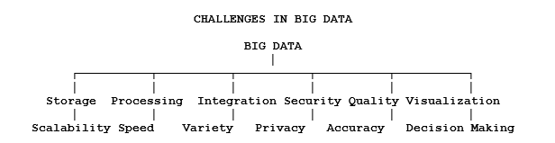
CHALLENGES WITH BIG DATA

Slide 35
1. Data Storage Challenge
One of the most significant challenges in Big Data is data storage. Modern organizations generate enormous amounts of data every second, making it impossible for traditional databases to store and manage such large datasets efficiently. As businesses expand, the volume of data grows from gigabytes to terabytes, petabytes, and even exabytes. Managing this rapidly increasing data requires distributed storage systems capable of storing data across multiple servers.
For example, YouTube receives hundreds of hours of video uploads every minute. Along with videos, it stores user comments, likes, subscriptions, thumbnails, and viewing history. Storing such an enormous amount of multimedia data on a single server is impossible. Therefore, YouTube uses distributed cloud storage and data centers spread across different geographical locations.

Slide 36
This challenge is addressed using technologies such as Hadoop Distributed File System (HDFS), cloud storage services, distributed databases, and data compression techniques.
Applications
YouTube
Netflix
Facebook
Google Photos
Amazon Web Services (AWS)

Slide 37
2. Data Processing Challenge
Processing Big Data is another major challenge because traditional processors cannot efficiently analyze massive datasets within a reasonable time. Organizations require fast processing techniques to analyze data and generate meaningful insights. Processing petabytes of data using a single computer may take several days or even weeks.
For instance, Amazon processes millions of customer searches, purchases, payments, product reviews, and recommendation requests every second. If all these operations were processed on a single server, customers would experience significant delays. Instead, Amazon distributes its computational workload across thousands of servers using parallel processing technologies.

Slide 38
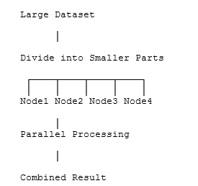
Frameworks such as Hadoop MapReduce, Apache Spark, and distributed computing platforms divide the workload into smaller tasks and process them simultaneously, greatly reducing execution time.
Applications
E-commerce
Banking
Scientific Research
Weather Forecasting
Search Engines

Slide 39
3. Data Integration Challenge
Organizations receive data from numerous heterogeneous sources. Integrating these different datasets into a single unified system is a complex task because each source stores information in different formats and structures. Data integration ensures that information from multiple systems can be analyzed together to support informed decision-making.
Consider a hospital, where patient information originates from laboratory systems, pharmacy databases, radiology departments, billing systems, insurance providers, and wearable medical devices. Since each system stores information differently, combining these datasets into a single patient record becomes challenging.
To overcome this issue, organizations use ETL (Extract, Transform, Load) processes, data integration platforms, and data warehousing techniques.
Applications
Healthcare
Banking
Government Services
Enterprise Resource Planning (ERP)
Business Intelligence

Slide 40
4. Data Quality Challenge
The quality of Big Data directly affects the accuracy of analytical results. Big Data often contains duplicate records, missing values, inconsistent formats, incorrect entries, and outdated information. Poor-quality data leads to inaccurate predictions and poor business decisions.
For example, an online shopping company may have duplicate customer records where one record contains the name "Ravi" while another contains "Ravi Kumar," although both belong to the same person. Similarly, incorrect addresses or missing phone numbers can affect product delivery and customer satisfaction.
Organizations improve data quality through data cleaning, validation, standardization, and deduplication techniques.
Applications
Customer Relationship Management (CRM)
Healthcare
Government Census
Banking

Slide 41
5. Security and Privacy Challenge
Big Data systems store vast amounts of sensitive and confidential information, making security one of the most critical challenges. Unauthorized access, cyberattacks, data breaches, and identity theft can cause severe financial and reputational damage.
For example, banks store customer account details, credit card information, transaction history, Aadhaar or PAN details, and loan records. If cybercriminals gain access to this information, millions of customers could be affected.
Organizations use encryption, authentication, authorization, firewalls, intrusion detection systems, and cybersecurity frameworks to protect sensitive data.
Applications
Online Banking
Healthcare
Government Portals
Insurance Companies

Slide 42
6. Scalability Challenge
As organizations continue to grow, their data also grows continuously. Big Data systems must be capable of handling increasing workloads without compromising performance. This ability is known as scalability.
For example, during festivals or major shopping events such as Amazon Prime Day or Flipkart Big Billion Days, millions of customers simultaneously browse products and place orders. The infrastructure automatically adds additional servers to accommodate the increased workload.
Cloud computing platforms and Hadoop clusters enable horizontal scaling by adding more servers whenever required.
Applications
• Cloud Computing
• E-commerce
• Video Streaming
• Social Media

Slide 43
7. Real-Time Data Processing Challenge
Many modern applications require immediate analysis of continuously generated data. Delayed processing may lead to incorrect decisions or missed opportunities. Therefore, real-time analytics has become an essential requirement for Big Data systems.
A good example is Google Maps, which continuously collects GPS coordinates and vehicle speeds from millions of smartphones. This information is processed instantly to estimate traffic congestion and suggest the fastest routes to users.
Technologies such as Apache Spark Streaming, Apache Kafka, and Apache Flink support real-time processing.
Applications
Stock Market Analysis
Traffic Monitoring
Fraud Detection
Smart Cities
Emergency Response Systems

Slide 44
8. Data Visualization Challenge
Although Big Data contains valuable insights, understanding millions of records in raw form is impossible. Data visualization converts complex datasets into charts, graphs, dashboards, and maps that help decision-makers quickly understand trends and patterns.
During the COVID-19 pandemic, governments displayed daily infection rates, vaccination statistics, and recovery trends using interactive dashboards instead of raw tables. These visualizations enabled authorities and citizens to understand the situation more effectively.
Popular visualization tools include Tableau, Microsoft Power BI, and Google Looker Studio.
Applications
• Business Intelligence
• Sales Analytics
• Healthcare Dashboards
• Government Reporting

Slide 45
9. Cost Challenge
Implementing and maintaining Big Data infrastructure requires substantial investment in storage, networking, processing power, software licenses, cloud services, and skilled professionals. Organizations must carefully manage these costs while ensuring high performance.
For example, Netflix stores petabytes of movies, customer preferences, recommendation data, and streaming logs. Running thousands of cloud servers continuously involves considerable operational expenditure.
Cloud computing reduces infrastructure costs through flexible pay-as-you-use pricing models.
Applications
Cloud Data Centers
Enterprise Analytics
Multimedia Streaming Platforms

Slide 46
10. Shortage of Skilled Professionals
Another major challenge is the shortage of professionals who possess expertise in Big Data technologies. Organizations require skilled data engineers, data scientists, cloud architects, machine learning engineers, and cybersecurity specialists to manage complex Big Data environments.
For example, a bank implementing AI-based fraud detection needs professionals who understand Hadoop, Spark, machine learning algorithms, cloud platforms, and cybersecurity. The limited availability of such experts often delays project implementation.
Organizations overcome this challenge through employee training, certification programs, and partnerships with educational institutions.
Applications
• Banking
• Healthcare
• Manufacturing
• Information Technology
• Telecommunications

Slide 47
Aptitude Question -4
A company's revenue increased by 25% in the first year, decreased by 20% in the second year, increased by 40% in the third year, and finally decreased by 30% in the fourth year.
If the initial revenue was ₹8 crore, what is the final revenue? What is the overall percentage change?

Slide 48
ANSWER
Successive percentage changes can be combined using multiplication factors:
Increase by 25% → × 1.25
Decrease by 20% → × 0.80
Increase by 40% → × 1.40
Decrease by 30% → × 0.70
Overall multiplier:
1.25×0.80×1.40×0.70 =0.98
Final revenue:
8×0.98=₹7.84 crores
Since the multiplier is 0.98, the company retains 98% of its original revenue.
Therefore, the net change is:
100%−98%=2% decrease

Slide 49
APTITUDE QUESTION
The population of a city consists of
40% children,
35% adults,
remaining senior citizens.
The number of children increases by 15%, adults decrease by 10%, and senior citizens increase by 20%.
If the final population becomes 11,07,000, find the original population.

Slide 50
Overall growth factor
=(40%×1.15)+(35%×0.90)+(25%×1.20)
=46%+31.5%+30%
=107.5%
Thus,
Final Population=107.5% of Original
1.075x=11,07,000
x=11,07,000/1.075≈10,29,767
Original Population: ≈10,29,767 ​ (approximately 10.30 lakh)
Final Population: 11,07,000

Slide 51
APTITUDE QUESTONS ON PROPORTION
A software development company has three categories of employees: Developers, Testers, and Business Analysts. Initially, the ratio of these employees is 8 : 5 : 3.
To meet the demand of a new project, the company recruits:
80 Developers
50 Testers
30 Analysts
After recruitment, the ratio becomes 12 : 8 : 5.
Determine the original number of employees in the company.

Slide 52
Solution
Let the original numbers be:
Developers = 8x
Testers = 5x
Analysts = 3x
After recruitment:
8x+80/12=5x+50/8
Cross multiplying,
x=10
Original employees
= (8+5+3)×10
= 160 employees
Answer: 160

Slide 53
TRADITIONAL BUSINESS INTELLIGENCE
Traditional Business Intelligence (BI) refers to a collection of technologies, applications, and practices used to collect, integrate, analyze, and present structured business information. BI primarily works with historical data stored in relational databases and data warehouses. It transforms raw transactional data into meaningful reports and dashboards that assist managers in strategic planning.
Traditional BI systems answer questions such as:
What happened last month?
Which product generated the highest sales?
Which region achieved maximum profit?
What is the quarterly revenue?
BI mainly focuses on descriptive analytics, helping organizations understand past business performance rather than predicting future outcomes.

Slide 54
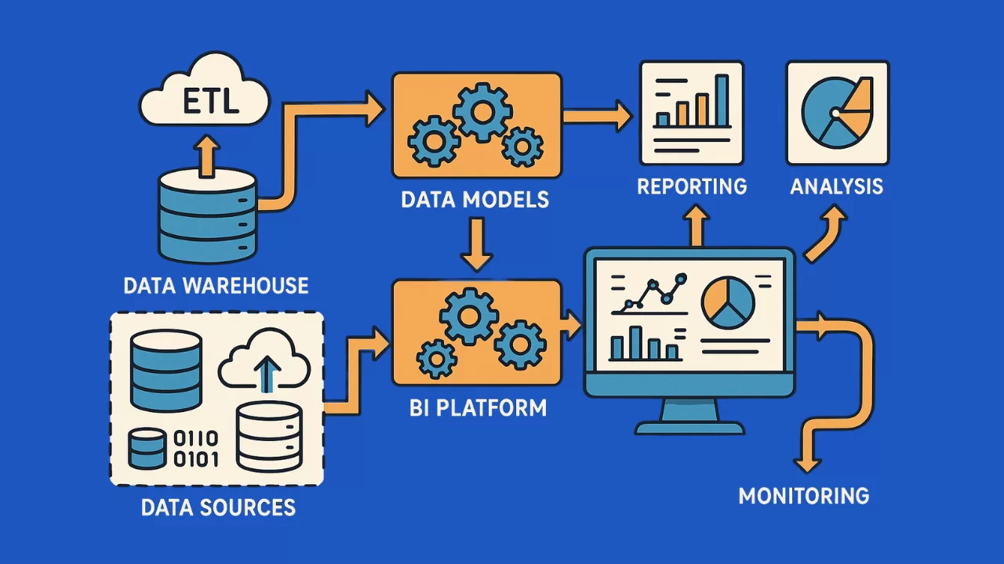

Slide 55
Characteristics of Traditional BI
1. Structured Data
Traditional BI primarily handles structured data stored in rows and columns inside relational databases.
Examples include:
Customer records
Employee salary details
Sales transactions
Banking records
Inventory details
Since the data follows predefined schemas, querying and reporting become straightforward.

Slide 56
2. Historical Data Analysis
BI analyzes previously stored business data to understand historical trends.
Example:
A retail company studies the sales data of the last five years to determine seasonal demand for air conditioners during summer.
3. Batch Processing
Traditional BI systems update reports periodically.
For example:
Daily reports
Weekly reports
Monthly reports
Quarterly reports
Real-time processing is generally not supported

Slide 57
4. Data Warehouse Centric
All operational data from multiple departments are cleaned, integrated, and stored inside a centralized Data Warehouse before analysis.
5. Standard Reports
Traditional BI generates predefined reports such as:
Profit and Loss Statement
Monthly Sales Report
Inventory Status
Employee Attendance Report

Slide 58
Real-Time Example 1: Banking
A national bank stores customer transaction details inside an Oracle database.
Every night,
ATM transactions
Branch transactions
Online banking transactions
are transferred into a Data Warehouse.
Managers receive daily reports showing:
Total deposits
Total withdrawals
Branch-wise revenue
Loan recovery statistics
Since the reports analyze yesterday's transactions, this is an example of Traditional BI.

Slide 59
Real-Time Example 2: Supermarket
A supermarket chain stores:
Daily sales
Inventory
Customer purchases
At the end of every month, management analyzes:
Best-selling products
Least-selling products
Monthly revenue
Supplier performance
The analysis is performed using historical transactional data.

Slide 60
Limitations of Traditional BI
1. Limited Data Volume
Traditional BI performs efficiently with gigabytes or terabytes of structured data.
However, modern organizations generate petabytes of information daily.
2. Structured Data Only
Traditional BI cannot efficiently analyze:
Images
Videos
Audio files
Social media posts
Sensor data
GPS information

Slide 61
3.Slow Processing
Before analysis,Data must be:
cleaned
transformed
loaded
into a Data Warehouse.
This process consumes significant time.
4. Limited Scalability
Increasing data size requires upgrading expensive hardware.
Scaling traditional databases becomes costly.
5.Lack of Real-Time Analytics
Traditional BI mainly analyzes historical information.
It cannot instantly process continuously arriving streaming data.

Slide 62
Big Data Analytics
Big Data refers to extremely large, fast-growing, and complex datasets that cannot be efficiently processed using traditional database management systems.
Big Data includes structured, semi-structured, and unstructured information generated from multiple sources.
Instead of only understanding what happened in the past, Big Data Analytics helps organizations:
predict future events
optimize operations
detect fraud
personalize customer experiences
automate decision-making

Slide 63
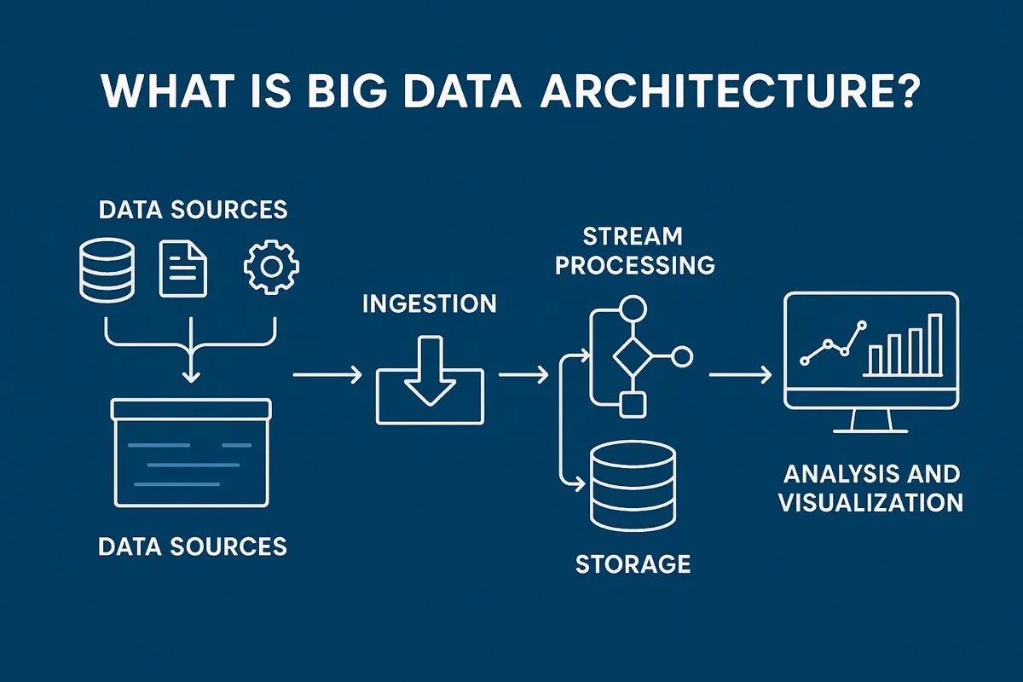

Slide 64
Characteristics of Big Data
1. Massive Data Volume
Organizations now generate:
Petabytes
Exabytes
Zettabytes of information every year.
Example:
Facebook generates billions of posts, comments, images, and videos daily.

Slide 65
2. Multiple Data Formats
Big Data stores:
Structured Data
Banking records
Semi-Structured Data
XML
JSON
Unstructured Data
Videos
Images
Audio
Tweets

Slide 66
3. High-Speed Data Generation
Data continuously flows from:
IoT devices
Mobile applications
Social media
Smart watches
GPS devices
Analytics often occurs in real time.
4. Distributed Storage
Instead of storing all information on one server,
Big Data stores information across hundreds or thousands of machines.
Technologies include:
Hadoop HDFS
Cloud Storage

Slide 67
5. Parallel Processing
Big Data processing frameworks divide large jobs into smaller tasks executed simultaneously on multiple machines.
Technologies include:
Hadoop MapReduce
Apache Spark

Slide 68
Real-Time Example 1: Amazon
Every second, Amazon collects:
Product searches
Purchase history
Cart items
Customer reviews
Click behavior
Delivery locations
Machine learning analyzes this enormous data in real time to recommend products.
Example:
When a customer purchases a laptop,
Amazon immediately recommends:
Laptop bag
Wireless mouse
Keyboard
Antivirus software
This recommendation engine relies on Big Data Analytics.

Slide 69
Real-Time Example 2: Healthcare
Modern hospitals collect:
MRI images
CT scans
ECG signals
Patient history
Wearable sensor data
Big Data Analytics combines these diverse datasets to detect diseases earlier and assist doctors in diagnosis.

Slide 70
Feature | Traditional Business Intelligence | Big Data
Data Size | GB to TB | TB to PB and beyond
Data Type | Structured | Structured, Semi-Structured, Unstructured
Storage | Relational Database | Hadoop HDFS, Cloud Storage
Processing | Batch Processing | Real-Time & Batch Processing
Database | SQL Databases | NoSQL, Hadoop Ecosystem
Architecture | Centralized | Distributed
Scalability | Limited | Highly Scalable
Cost | High for scaling | Lower using commodity hardware
Analytics | Descriptive | Descriptive, Predictive, Prescriptive
Data Sources | ERP, CRM, Transactions | Social Media, IoT, Mobile Apps, Sensors, Videos, Logs
Query Speed | Moderate | Fast using distributed computing
Flexibility | Low | Very High
Fault Tolerance | Limited | High (data replicated across nodes)
Decision Making | Historical | Real-Time and Predictive

Slide 71
Coexistence of Both Systems
Banking Scenario
Traditional BI
A bank analyzes last month's customer transactions to determine:
Monthly deposits
Branch performance
Loan repayments
Revenue generation
The reports are prepared overnight using data stored in a Data Warehouse. Managers use these reports to review historical performance and plan future strategies.
Big Data
The same bank continuously monitors millions of credit card transactions in real time. Machine learning models analyze transaction patterns as they occur. If an unusual transaction—such as a large purchase from a foreign country immediately after a local transaction—is detected, the system flags it as potential fraud within seconds and temporarily blocks the card, helping prevent financial loss.

Slide 72
Data Warehouse and Hadoop Environment
A data warehouse and a Hadoop environment are two different concepts and technologies used in managing and processing large amounts of data.
Data Warehouse:
A data warehouse is a central repository that stores structured, historical data from various sources within an organization.
It is designed to support business intelligence (BI) and reporting activities

Slide 73
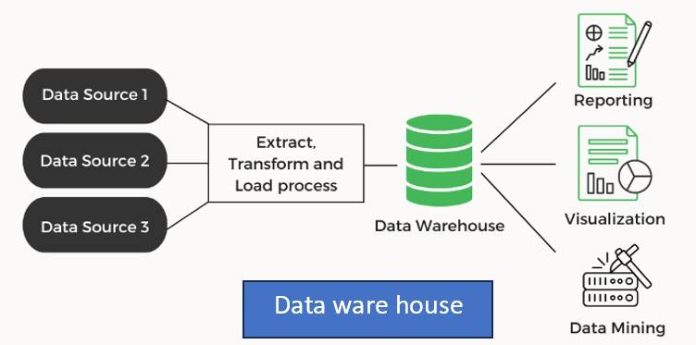

Slide 74
Key Aspects Of A Data Warehouse:
Structure:
Data warehouses use a relational database management system (RDBMS) to store data in a structured format.
Data is organized into tables, rows, and columns, following a predefined schema called a dimensional model.
The dimensional model typically consists of fact tables (containing numeric measures) and dimension tables (providing context and descriptive attributes).

Slide 75
ETL Processes:
Extract, Transform, Load (ETL) processes are used to populate the data warehouse.
Data is extracted from different sources, transformed to adhere to the data warehouse schema, and then loaded into the warehouse.
ETL processes often involve data cleansing, integration, and aggregation to ensure data quality and consistency.
Historical Data:
Data warehouses primarily store historical data, providing a long-term view of the organization's operations.
Data is typically collected at regular intervals, such as daily, weekly, or monthly, allowing for trend analysis and historical reporting

Slide 76
Business Intelligence and Reporting:
Data warehouses serve as a foundation for business intelligence activities.
They support ad hoc querying, reporting, and analysis by providing a consolidated view of data across different business areas.
Data is often pre-aggregated and optimized for query performance to facilitate fast and interactive reporting.

Slide 77
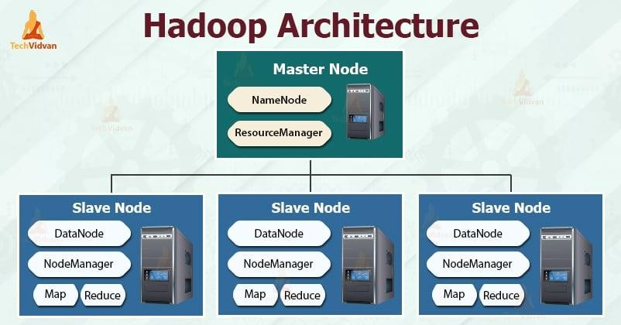
Hadoop Environment

Slide 78
HADOOP
Hadoop is an open-source framework that enables distributed storage and processing of large datasets across clusters of commodity hardware. It provides a scalable and cost-effective solution for managing Big Data.
Distributed Storage:
Hadoop uses the Hadoop Distributed File System (HDFS) to store data across multiple nodes in a cluster.
Data is split into blocks and distributed across the cluster, ensuring high availability and fault tolerance.
Distributed Processing:
Hadoop leverages the MapReduce framework to process data in parallel across the cluster. MapReduce divides data processing tasks into smaller subtasks and distributes them to different nodes, allowing for efficient parallel processing

Slide 79
Scalability:
Hadoop is designed to scale horizontally by adding more nodes to the cluster. This enables organizations to store and process large volumes of data without relying on expensive and specialized hardware.
Flexibility and Variety:
Hadoop can handle various types of data, including structured, unstructured, and semi-structured data. It allows organizations to store and process diverse data formats, such as text, log files, images, videos, and more.

Slide 80
Data Processing Frameworks:
Hadoop ecosystem includes several data processing frameworks and tools built on top of Hadoop, such as Apache Spark, Apache Hive, and Apache Pig.
These frameworks provide higher-level abstractions and APIs for data manipulation, querying, and analysis.
Batch and Real-time Processing:
Hadoop supports both batch processing and real-time/streaming processing.
While its MapReduce framework is suitable for batch processing, tools like Apache Spark enable real-time and near-real-time analytics on streaming data.

Slide 81
Big data analytics
Big data analytics is the process of extracting meaningful insights from big data, such as hidden patterns, unknown correlation, market trends and customer preferences, that can help organizations make informed business decisions.
There are quite a few advantages to incorporating big data analytics into a business or organization. These include:
  Cost reduction: big data can reduce costs in storing all the business data in one place. Tracking analytics also helps companies find ways to work more efficiently to cut costs wherever possible.
  Product development: Developing and marketing new products, services, or brands is much easier when based on data collected from customers’ needs and wants. Big data analytics also helps businesses understand product viability and keep up with trends.

Slide 82
  Strategic business decisions: The ability to constantly analyze data helps businesses make better and faster decisions, such as cost and supply chain optimization.
  Customer experience: Data-driven algorithms help marketing efforts (targeted ads, for example) increase customer satisfaction by delivering an enhanced customer experience.
  Risk management: Businesses can identify risks by analyzing data patterns and developing solutions for managing those risks.

Slide 83
Classification of Data analytics
Data analytics can be of four types depending on the type and scope of analysis being conducted on the data set.
  Descriptive analytics
  Diagnostic analytics
  Predictive analytics
  Prescriptive analytics

Slide 84
Descriptive analytics: What happened
Descriptive analytics uses historical data from a single internal source to describe what happened.
For example: How many people viewed the website?
Which products had the most defects?
Used by most businesses, descriptive analytics forms the crux of everyday reporting, especially through dashboards.
Diagnostic analytics: Why did it happen?
Diagnostic analytics is a form that dives deep into historical data to identify anomalies, find patterns, identify correlations, and determine causal relationships.
With the help of diagnostic analysis, data analysts can understand why a certain product did not do well in the market, or why customer satisfaction decreased in a certain month.

Slide 85
Predictive analytics: What might happen next?
This is a more advanced form of analytics that is often used to answer the question ‘what will happen next?’ in a business situation.
As the name suggests, this data analytics type predicts the future outcome of a situation depending on all the available data.
This data will include both market trends and older data about your business performance, By combining these two, this data analytics type can predict how your business will perform during the next season
Prescriptive analytics: What do I need to do?
Prescriptive analytics is the most complex type of analytics.
It combines internal data, external sources, and machine-learning techniques to provide the most effective recommendations for business decisions.

Slide 86
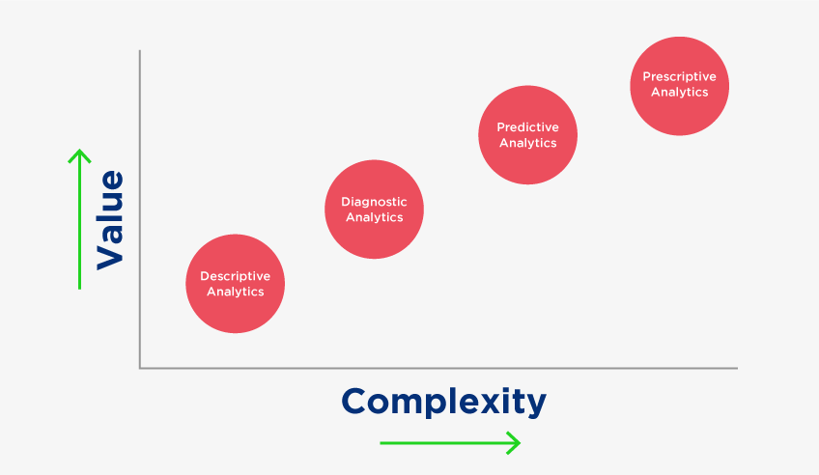

Slide 87
Top analytical tools
Python:
Python is a versatile programming language widely used for data analysis and scientific computing.
It offers numerous libraries and frameworks, such as pandas, NumPy, and scikit-learn, which provide powerful data manipulation, analysis, and machine learning capabilities.
R:
R is a programming language and environment specifically designed for statistical computing and graphics.
It offers a wide range of packages and libraries for data manipulation, analysis, and visualization.
R is popular among statisticians and data scientists for its extensive statistical modeling capabilities

Slide 88
Apache Spark:
Apache Spark is an open-source distributed computing system that provides fast and scalable data processing and analytics capabilities.
It supports various programming languages and offers libraries for distributed data processing, machine learning, and graph analytics.
Apache Hadoop: Apache Hadoop is an open-source framework for distributed processing of large datasets.
It provides a scalable and fault-tolerant platform for storing, processing, and analyzing big data.
Hadoop includes components such as Hadoop Distributed File System (HDFS) and MapReduce for distributed data processing.

Slide 89
Cassandra
APACHE Cassandra is an open-source NoSQL distributed database that is used to fetch large amounts of data.
It is capable of delivering thousands of operations every second and can handle petabytes of resources with almost zero downtime.
Mongo DB
It is a free, open-source platform and a document-oriented (NoSQL) database that is used to store a high volume of data.
It uses collections and documents for storage and its document consists of key-value pairs which are considered a basic unit of Mongo DB.
It is so popular among developers due to its availability for multi-programming languages such as Python, Jscript, and Ruby

Slide 90
Tableau:
Tableau is a powerful and user-friendly data visualization and business intelligence tool.
It allows users to create interactive dashboards, reports, and visualizations from various data sources. Tableau supports advanced analytics, data blending, and provides intuitive drag-and-drop functionality.
Microsoft Power BI:
Microsoft Power BI is a business intelligence tool that helps users analyze data and share insights.
It provides interactive dashboards, data visualization, and reporting capabilities.
Power BI integrates with various data sources, offers AI-powered features, and supports collaboration and data sharing.

Slide 91
SAS:
SAS (Statistical Analysis System) is a comprehensive suite of analytics tools widely used in industries such as finance, healthcare, and government.
It provides a wide range of functionalities for data management, advanced analytics, and reporting.
QlikView/Qlik Sense:
QlikView and Qlik Sense are data visualization and business intelligence tools that enable users to explore and analyze data visually.
They offer drag-and-drop functionality, interactive dashboards, and powerful data discovery capabilities.
MATLAB:
MATLAB is a programming and numerical computing environment widely used in academia and industry.
It offers comprehensive tools for data analysis, modeling, and simulation, along with built-in algorithms and functions for various analytical tasks.

